Slide 1
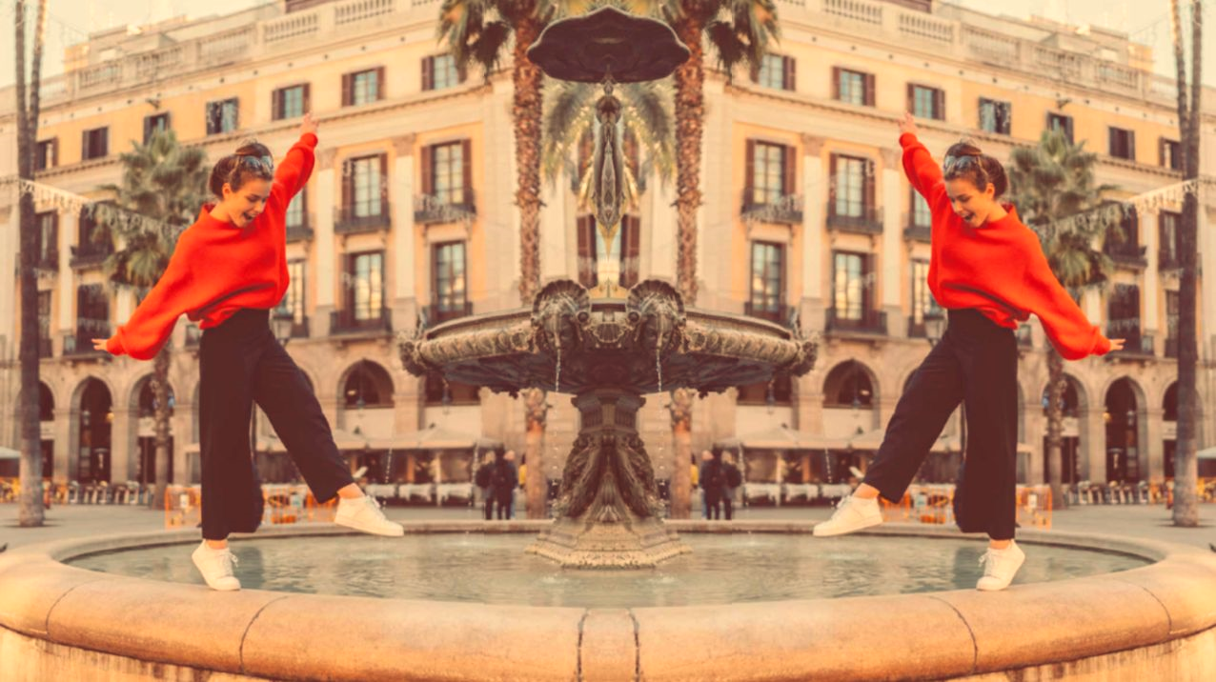
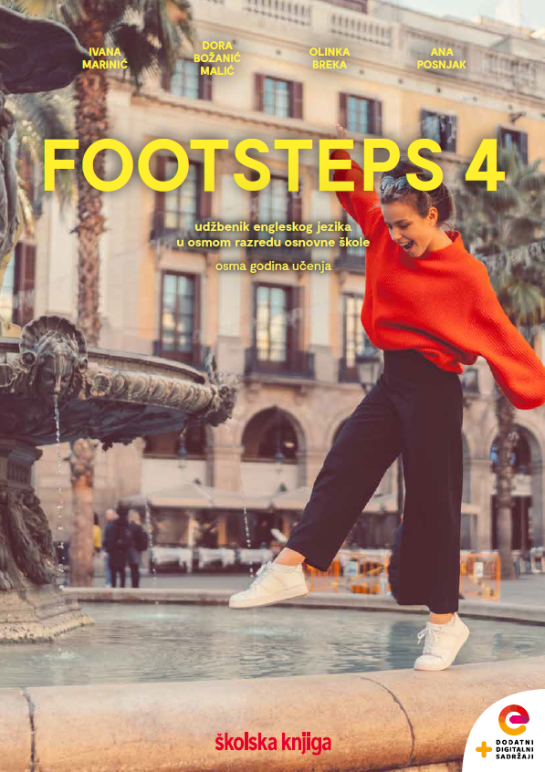

UNIT 1; All too human
Lesson 2; Look at Fred

Slide 2
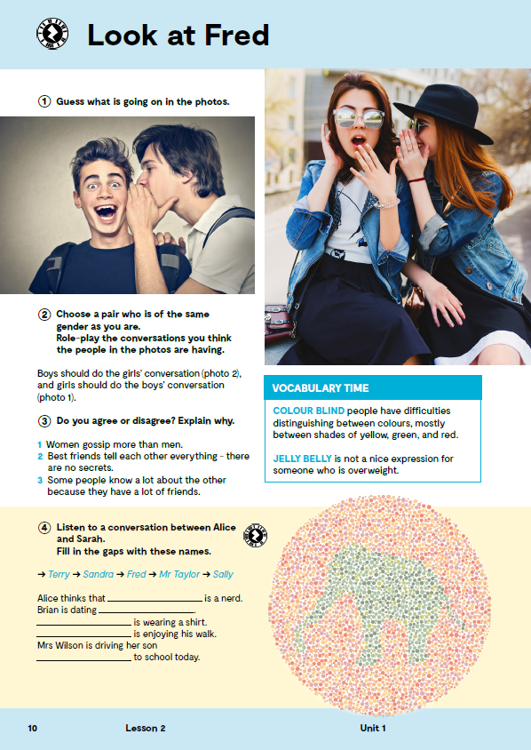
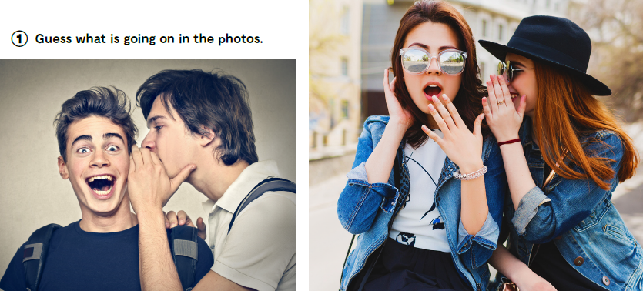
Do you sometimes talk behind your friend’s back about his/her grades/haircut/clothes? Pričaš li nekad svojim prijateljima iza leđa o njihovim ocjenama/frizurama/odjeći?
Do you keep your friend’s secrets? Čuvaš li tajne svojih prijatelja?
Guess what is going on in the photos.

Slide 3

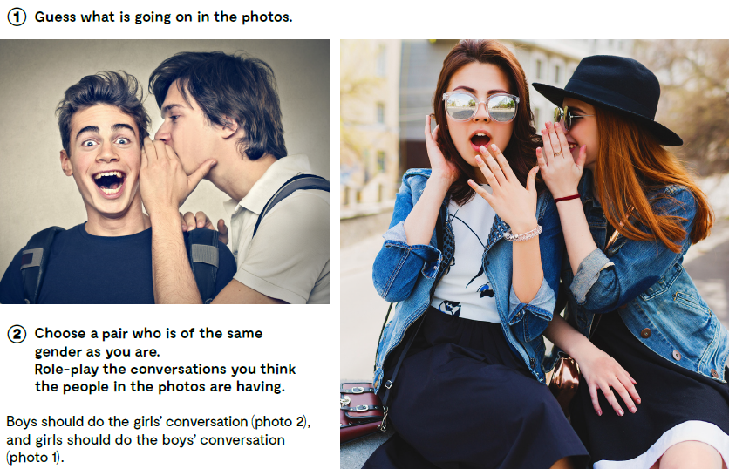
Choose a pair who is of the same gender as you are.
Write down the conversations you think the people in the photos are having.
Boys should do the girls’ conversation (photo 2), and girls should do the boys’ conversation (photo 1). .

Slide 4
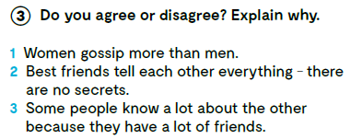
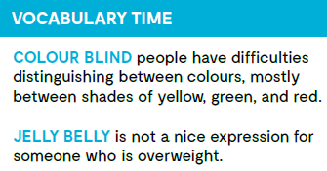
COLOUR BLIND – osoba koja ima poteškoća u razlikovanju boja, najčešće između nijansi žute, zelene i crvene.
JELLY BELLY – ne baš lijep izraz za nekoga tko se bori s viškom kilograma
gossip
discomfort
a nerd
earplugs
an exception
trač, tračati
neugoda
šmokljan
čepići za uši
iznimka
allegedly
knowledgeable
an appointment
navodno
pun znanja
dogovor

Slide 5
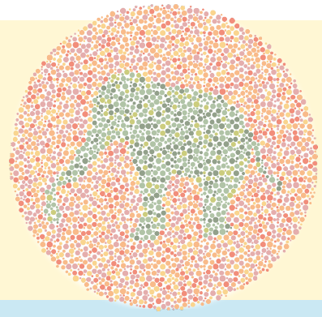
Are you colour blind? Open the links and check. https://www.youtube.com/watch?v=yxnDz_OtF5s
https://www.youtube.com/watch?v=emEKDww0iac

Slide 6
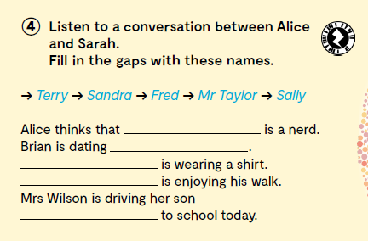

Listen to a conversation between Alice and Sarah. Fill in the gaps with these names. https://www.e-sfera.hr/dodatni-digitalni-sadrzaji/e08d1113-51a1-4b3e-abd0-28b0fe9b745e/assets/audio/02_unit_1__lesson_2__exercise_4_5.mp3
Fred
Sandra
Sally
Mr Taylor
Terry

Slide 7
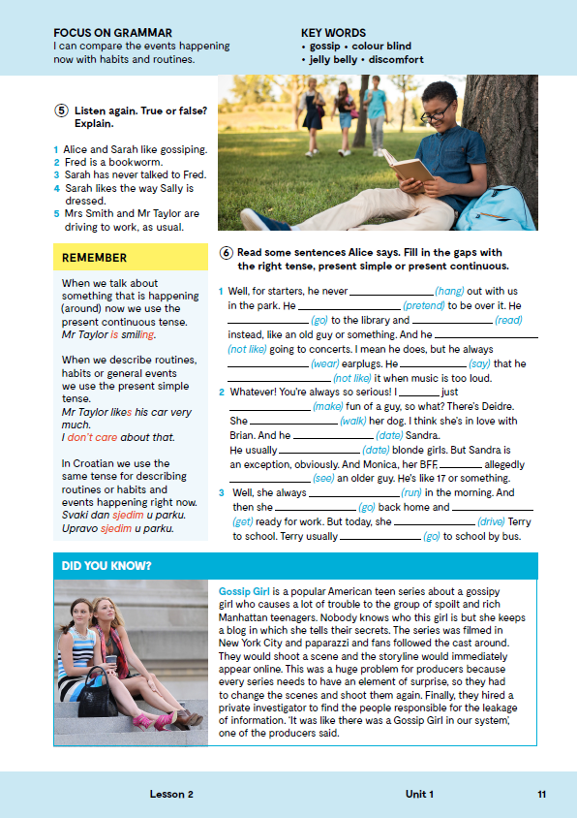
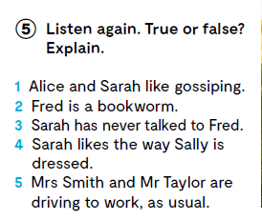
On the next page, page 11.
Listen again. True or false? https://www.e-sfera.hr/dodatni-digitalni-sadrzaji/e08d1113-51a1-4b3e-abd0-28b0fe9b745e/assets/audio/02_unit_1__lesson_2__exercise_4_5.mp3
F
T
F
T
F
Koja su dva glagolska vremena koristile Alice i Sarah? Mrs Smith always runs in the morning, but today she is driving Terry to school. Mr Taylor is walking to school and he usually drives his car.

Slide 8
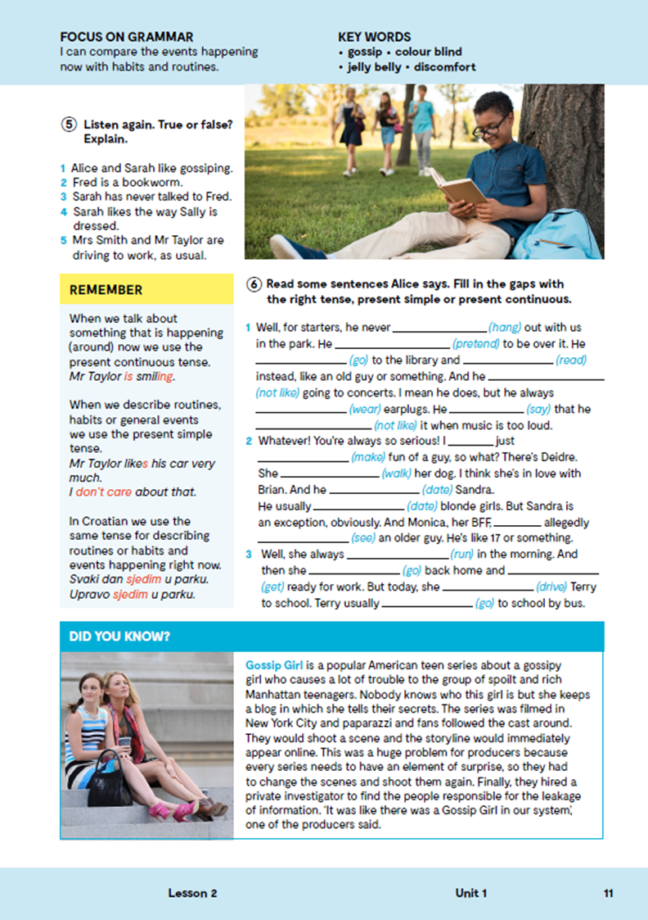
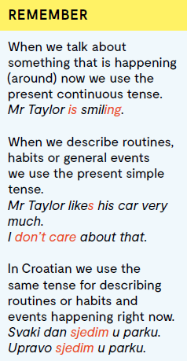
Za radnju koja se događa SADA (NOW!) koristimo Present Continuous, dok za ono što je NAVIKA ili RUTINA (always, often, usually, sometimes, every…) koristimo Present Simple. Ti glagoli u hrvatskom jeziku imaju isti oblik, bilo da se radi o trenutnoj radnji ili o navikama. VIDEO GRAMMAR poveznica: https://www.e-sfera.hr/dodatni-digitalni-sadrzaji/e08d1113-51a1-4b3e-abd0-28b0fe9b745e/

Slide 9
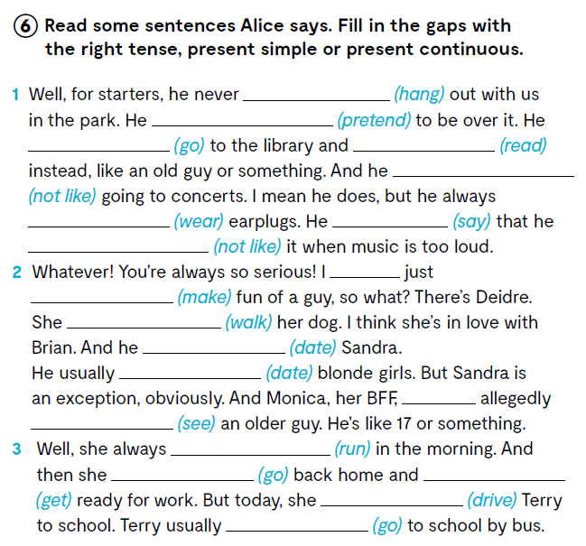
Read some sentences Alice says. Fill in the gaps with the right tense, present simple or present continuous.
hangs
pretends
goes
reads
doesn’t like
wears
says
doesn’t like
am
making
Is walking
is dating
dates
is
seeing
Present simple or present continuous? https://learningapps.org/watch?v=pig22aw0t21
runs
goes
gets
is driving
goes

Slide 10
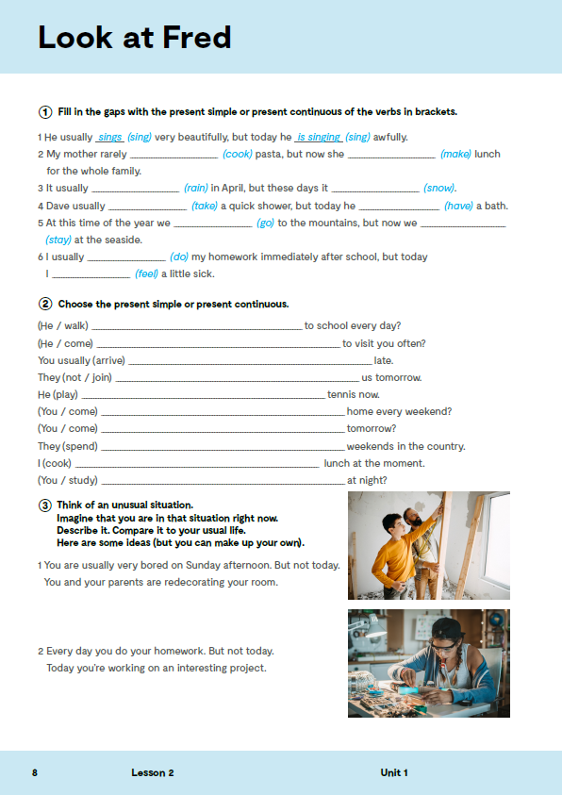
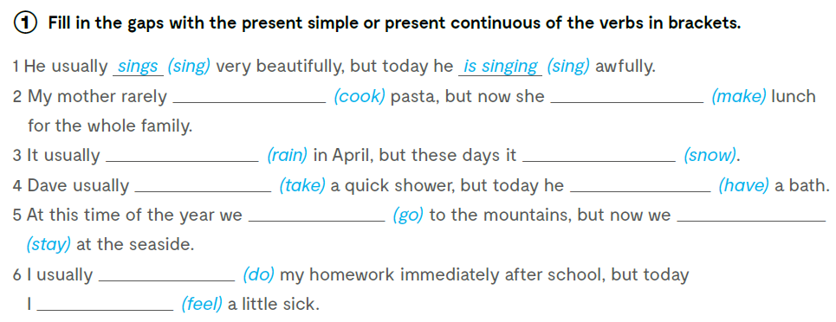
Open your exercise book, page 8.
Fill in the gaps with the present simple or present continuous of the verbs in brackets.
cooks
is making
rains
is snowing
takes
is having
go
are staying
do
am feeling

Slide 11

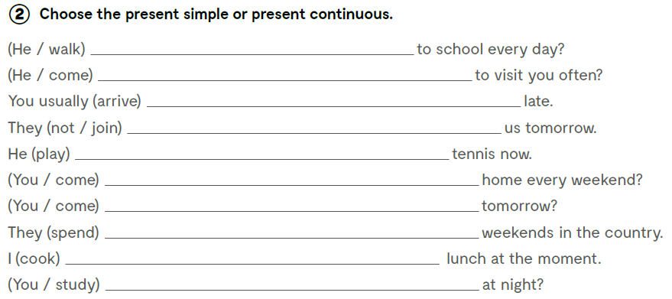
Choose the present simple or present continuous.
Does he walk
Does he come
arrive
are not joining
is playing
Do you come
Are you coming
spend
am cooking
Do you study

Slide 12
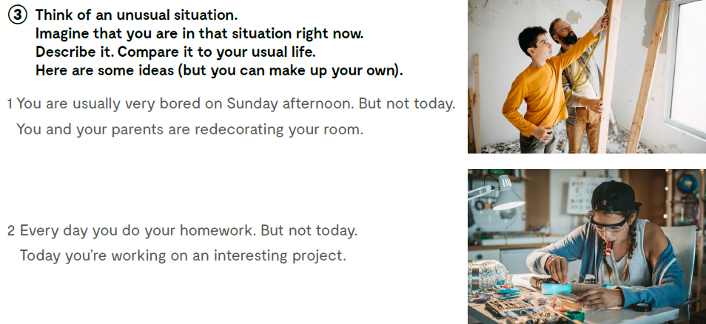
Think of an unusual situation. Imagine that you are in that situation right now. Describe it. Compare it to your usual life. Here are some ideas (but you can make up your own).

Slide 13

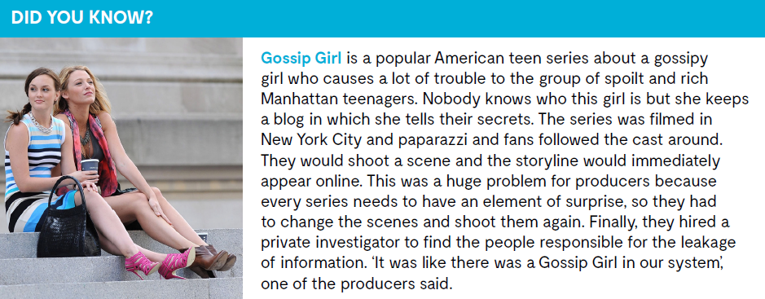

Slide 14

LEARN MORE!
https://www.e-sfera.hr/dodatni-digitalni-sadrzaji/e08d1113-51a1-4b3e-abd0-28b0fe9b745e/
Can gossiping be a good thing?

Slide 15
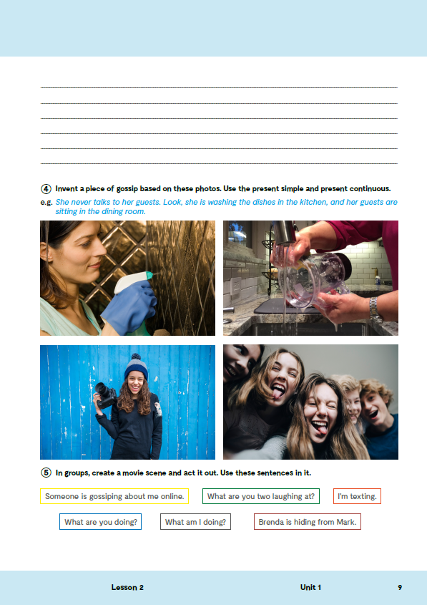
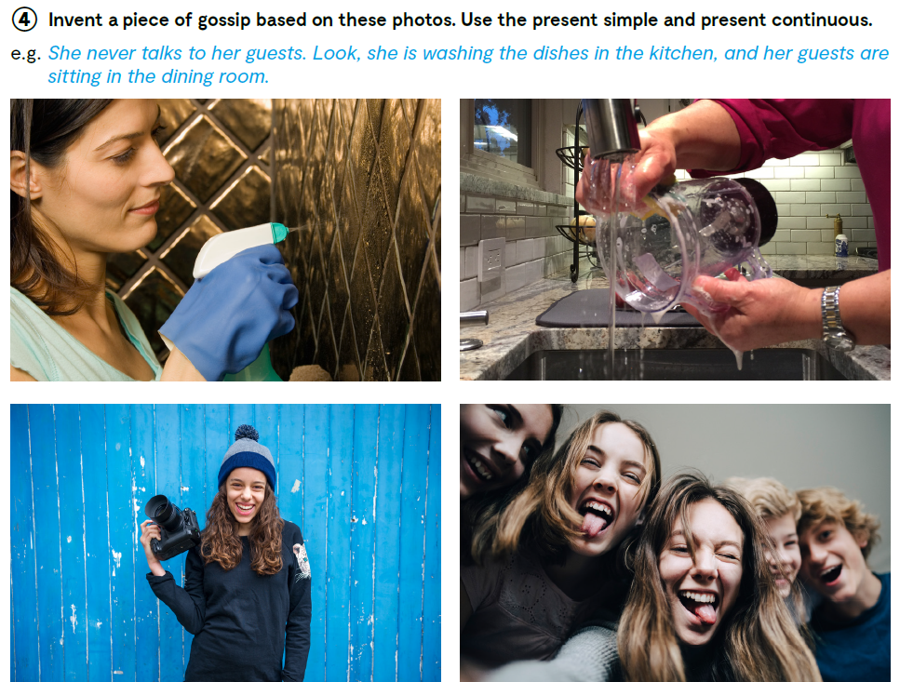
Open your exercise book, page 9.
Invent a piece of gossip based on these photos. Use the present simple and present continuous.

Slide 16
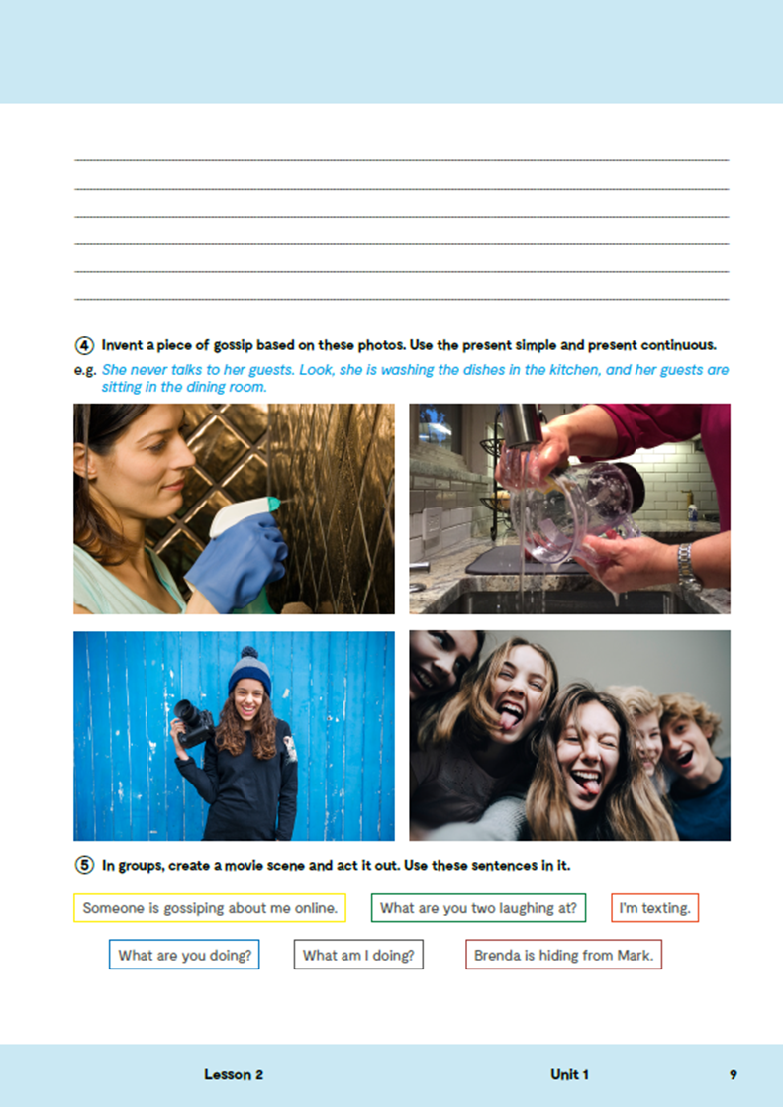
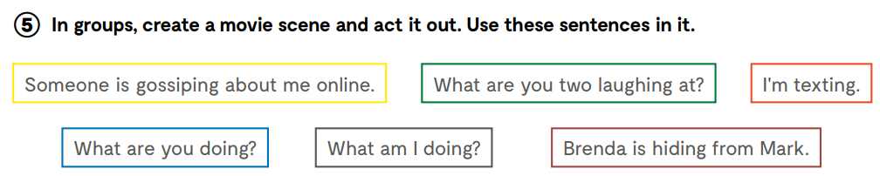
Create a movie scene and make a cartoon using one of the online tools. Use these sentences in it.

